Slide 1
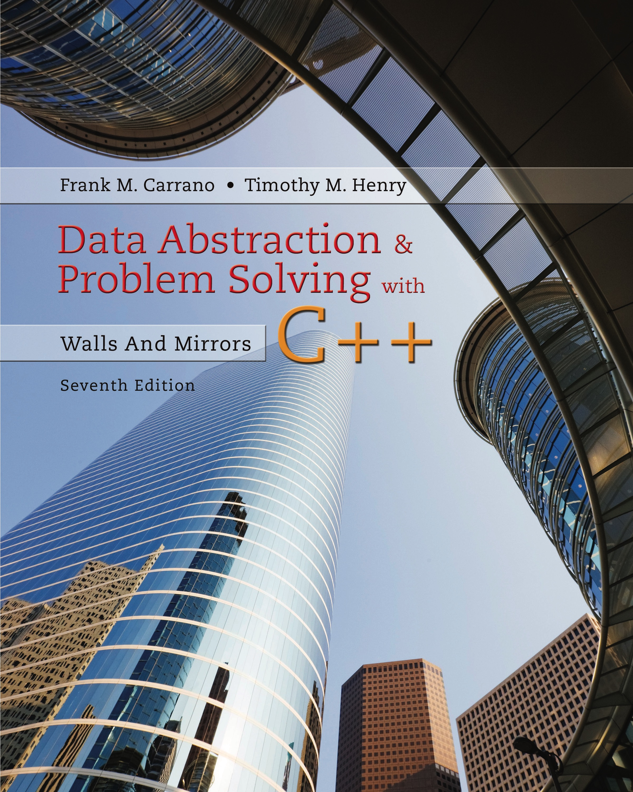
Data Abstraction & Problem Solving with C++: Walls and Mirrors
Seventh Edition
Chapter 1
Data Abstraction: The Walls
Copyright © 2017, 2013, 2007 Pearson Education, Inc. All Rights Reserved
Notes:
If this PowerPoint presentation contains mathematical equations, you may need to check that your computer has the following installed:
1) MathType Plugin
2) Math Player (free versions available)
3) NVDA Reader (free versions available)

Slide 2
Object-Oriented Concepts
Object-oriented analysis and design (O O A D)
Process for solving problems
Solution
Computer program consisting of system of interacting classes of objects
Object
Has set of characteristics, behaviors related to solution

Slide 3
Object-Oriented Analysis & Design
Requirements of a solution
What solution must be, do
Object-oriented design
Describe solution to problem
Express solution in terms of software objects
Create one or more models of solution

Slide 4
Aspects of Object-Oriented Solution
Principles of object-oriented programming
Encapsulation: Objects combine data and operations.
Inheritance: Classes inherit properties from other classes.
Polymorphism: Objects determine appropriate operations at execution time.

Slide 5
Cohesion
Each module should perform one well-defined task
Benefits
Well named, self-documenting
Easy to reuse
Easier to maintain
More robust

Slide 6
Coupling (1 of 2)
Measure of dependence among modules
Dependence
Sharing data structures or calling each other’s methods
Modules should be loosely coupled
Highly coupled modules should be avoided

Slide 7
Coupling (2 of 2)
Benefits of loose coupling in a system
More adaptable to change
Easier to understand
Increases reusability
Has increased cohesion

Slide 8
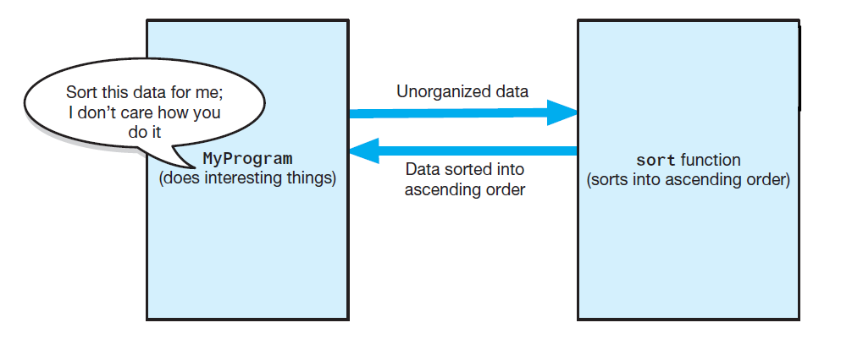
Specifications
Figure 1-1 The task sort is a module separate from the MyProgram module

Slide 9
Operation Contracts
Documents
How method can be used
What limitations it has
Specify
Purpose of modules
Data flow among modules
Pre-, post-condition, input, output of each module

Slide 10
Unusual Conditions
Ways to address invalid conditions:
Assume they will not happen
Ignore such situations
Guess at client’s intentions
Return value that signals problem
Throw an exception

Slide 11
Abstraction
Separate purpose of a module from its implementation
Specifications do not indicate how to implement
Able to use without knowing implementation

Slide 12
Information Hiding (1 of 3)
Abstraction helps identify details that should be hidden from public view
Ensured no other module can tamper with these hidden details.
Isolation of the modules cannot be total, however
Client must know what tasks can be done, how to initiate a task

Slide 13
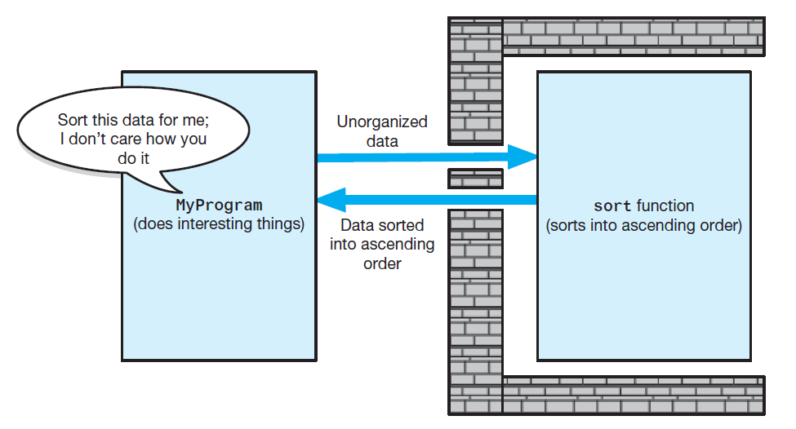
Information Hiding (2 of 3)
Figure 1-2 Tasks communicate through a slit in the wall

Slide 14
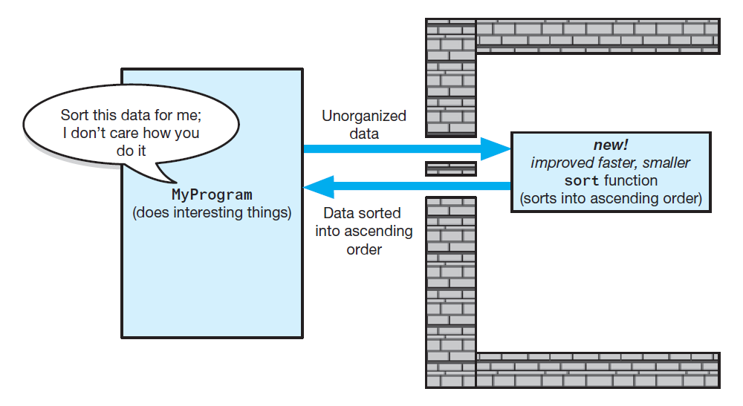
Information Hiding (3 of 3)
Figure 1-3 A revised implementation communicates through the same slit in the wall

Slide 15
Minimal and Complete Interfaces
Interface for a class made up of publicly accessible methods and data
Complete interface for a class
Allows programmer to accomplish any reasonable task
Minimal interface for a class
Contains method if and only if that method is essential to class’s responsibilities

Slide 16
Abstract Data Types (A D T) (1 of 3)
Typical operations on data
Add data to a data collection.
Remove data from a data collection.
Ask questions about the data in a data collection.
An A D T : a collection of data and a set of operations on data
A data structure : an implementation of an A D T within a programming language

Slide 17
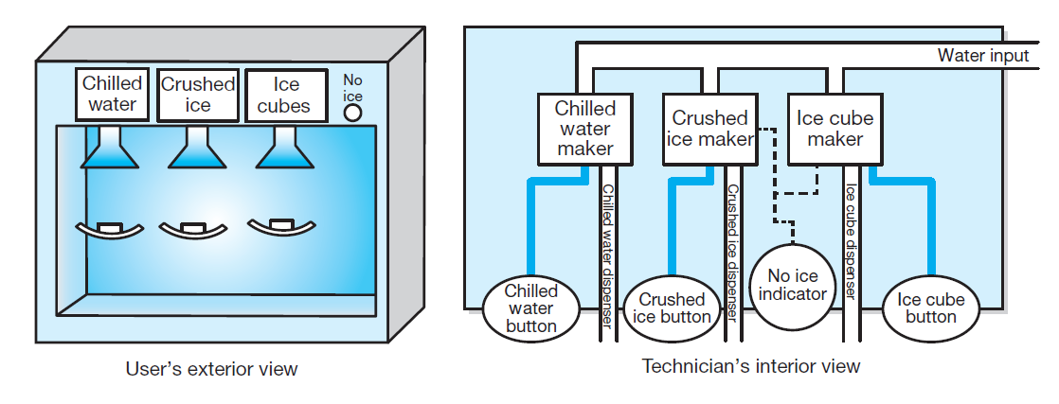
Abstract Data Types (A D T) (2 of 3)
Figure 1-4 A dispenser of chilled water, crushed ice, and ice cubes

Slide 18
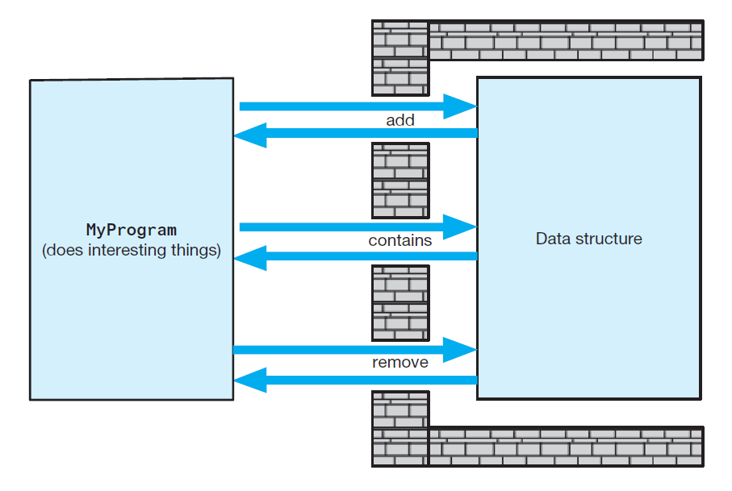
Abstract Data Types (A D T) (3 of 3)
Figure 1-5 A wall of A D T operations isolates a data structure from the program that uses it

Slide 19
Designing an A D T
Evolves naturally during the problem-solving process
What data does a problem require?
What operations does a problem require?
A D T s typically have initialization and destruction operations
Assumed but not specified at this stage

Slide 20
A D T s That Suggest Other A D T s
You can use an A D T to implement another A D T
Example: Date-Time objects available in C + + for use in various contexts
Possible to create your own fraction object
to use in some other object which required fractions

Slide 21
The A D T Bag
Consider the bag to be an abstract data type.
We are specifying an abstraction inspired by an actual physical bag
Doesn’t do much more than contain its items
Can unordered and possibly duplicate objects
We insist objects be of same or similar types
Knowing just its interface
Can use A D T bag in a program

Slide 22
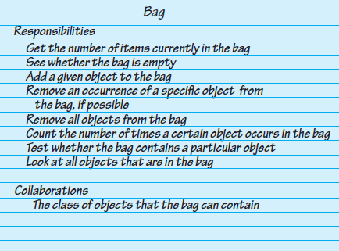
Identifying Behaviors
Figure 1-6 A C R C card for a class Bag

Slide 23
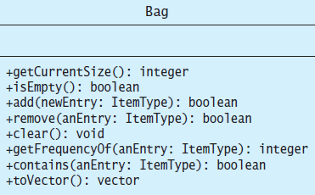
Specifying Data and Operations
Figure 1-7 U M L notation for the class Bag

Slide 24
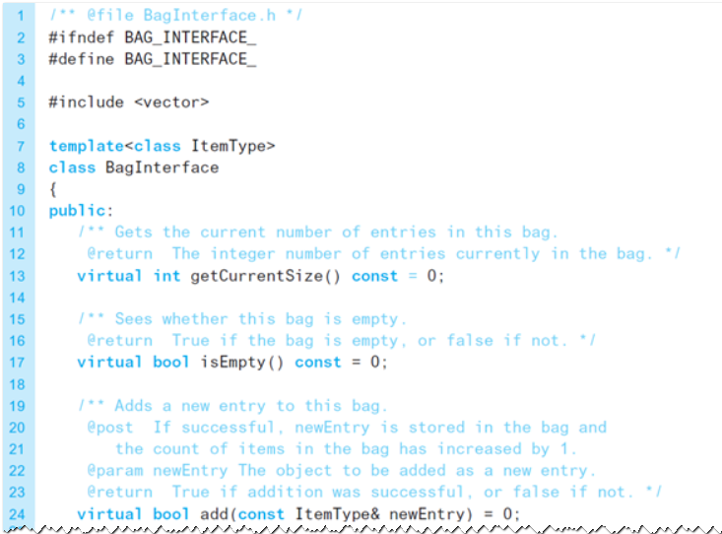
An Interface Template for the A D T (1 of 3)
Listing 1-1 A file containing a C++ interface for bags

Slide 25
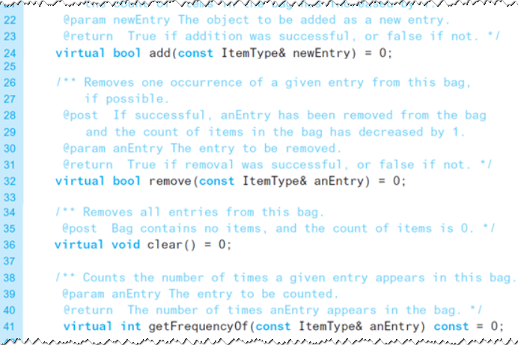
An Interface Template for the A D T (2 of 3)
Listing 1-1 A file containing a C++ interface for bags

Slide 26
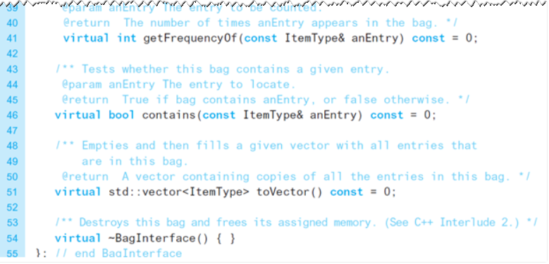
An Interface Template for the A D T (3 of 3)
Listing 1-1 A file containing a C++ interface for bags

Slide 27
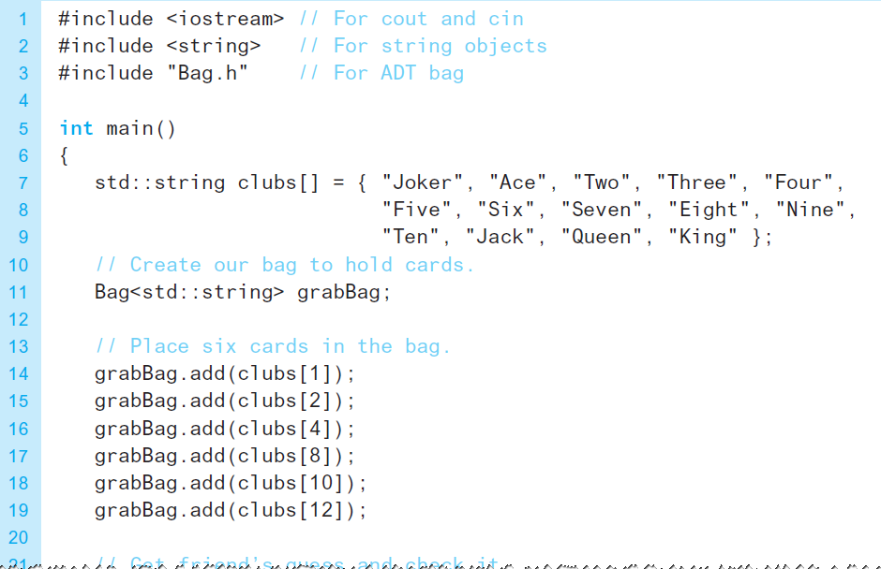
Using the A D T Bag (1 of 2)
Listing 1-2 A program for a card guessing game

Slide 28
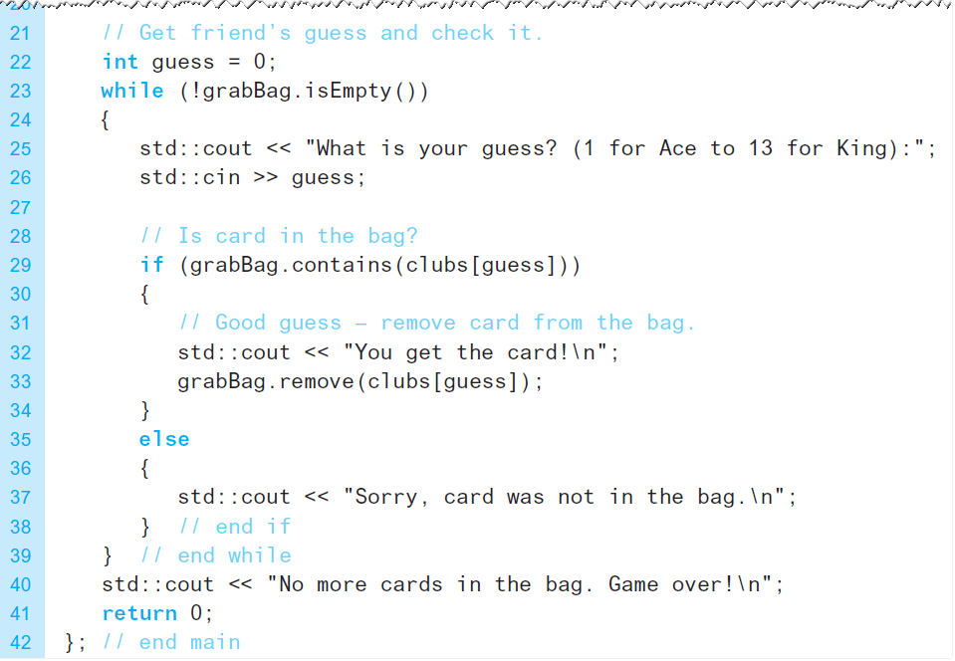
Using the A D T Bag (2 of 2)
Listing 1-2 A program for a card guessing game

Slide 29

Copyright

